Slide 1
TypeScript JavaScript + NXT
@basarat
Google it

Slide 2
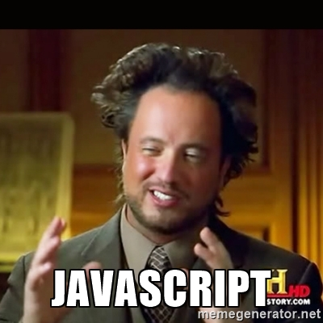

Slide 3
LESS WAT

Slide 4

WAT

Slide 5

AWWW

Slide 6

WAT

Slide 7
JavaScript
[].asdf()
TypeError:
[].asdf is not a function

Slide 8
JavaScript
[] + []

Slide 9
JavaScript
[] + []
""

Slide 10
JavaScript
[] + {}

Slide 11
JavaScript
[] + {}
"[object Object]"

Slide 12
JavaScript
{} + []
!= [] + {}

Slide 13
JavaScript
{} + []
0

Slide 14
JavaScript
{} + {}

Slide 15
JavaScript
{} + {}
V8
"[object Object][object Object]"

Slide 16
JavaScript
{} + {}
IE
NaN

Slide 17
JavaScript
"hello " + 1
hello 1

Slide 18
JavaScript
"hello " + (-1)
hello -1

Slide 19


Slide 20
JavaScript
"hello " - 1

Slide 21
JavaScript
"hello " - 1
NaN

Slide 22


Slide 23
We can lint this
"hello " - 1

Slide 24
Lint this?
function add(a,b){ return a+b }
add([], {})

Slide 25
Lint this?
function add(a,b){ return a+b }
add(foo, bar)

Slide 26
Lint this?
let foo = getServerFoo();
let bar = getServerBar();
someModule.add(foo,bar);

Slide 27

Linter on Steroids

Slide 28
JavaScript
let foo = [] + []
let bar = {} + []
let baz = [] + {}
let qux = {} + {}
let tix = "" - 123

Slide 29
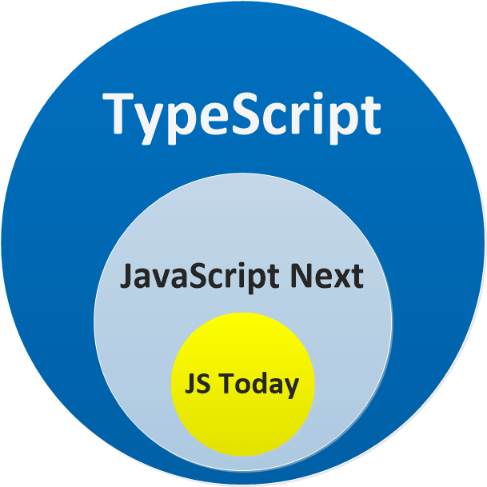

Slide 30
DEMO
Just a JS file
A JS Project

Slide 32


Slide 33


Slide 34


Slide 36
QUESTIONS

Slide 37


alm.tools
Google:
TypeScript Book

Slide 38
@basarat

